Slide 1
OpenGL Pipeline
Hosein Ghahremanzadeh
Notes:
The background is a sample of volumetric lighting in my own 3D graphics engine, HG3D

Slide 2

Things to notice about OpenGL
OpenGL is a state machine.
OpenGL uses the client-server model.
OpenGL processes the data on a pipeline.
Notes:
OpenGL is a state machine this means that the behavior of the machine depends on its current state.
OpenGL uses client server model, this means that the program using the API (the client) sends commands to server (anything that implements the OpenGL) and sets the sate of the server, or causes it to process data, and receives the processed data.
Even though the OpenGL is mostly intended to be implemented on a GPU, the are no constraints for its implementation. The only constraints are for the behavior of the functions, so the could also be a CPU implementation of the OpenGL.
This is one of the most important aspect of the OpenGL, this means that each stage of the pipeline does its process, and passes the processed data to the next stage.
This also means that we can have bottlenecks on the pipeline, meaning the slowest stage defines the performance characteristics of the pipeline.

Slide 3
OpenGL versions
Core and compatibility versions.
Each OpenGL version has a corresponding shader language version.
We will be discussing OpenGL 4.5.
Notes:
Core version does not support the fixed-function pipeline, to allow backwards compatibility there is a compatibility version that allows use of this functionality.
We will talk further about shaders.
There are many similarities between OpenGL 4.5 and older version till 3.3, though there are differences that will be discussed further in as we see them.

Slide 4
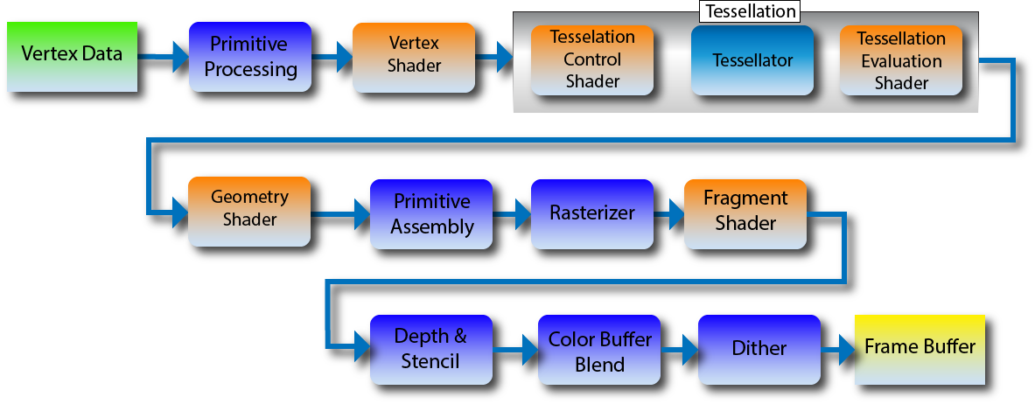
OpenGL pipeline
Notes:
The pipeline processes data, and stores the result in a memory. The input of the pipeline is vertex data and the processed data is stored in frame buffer memory. We will go through some parts of this pipeline, and explain the basics in more detail.
This is not a fixed pipeline in the sense that some of the stage can be programmed and their behavior depends on the programs loaded on them. These stages are represented in orange. The rest of the pipeline is fixed since they can not be programmed, but the state of the OpenGL effects their behavior.
The programs loaded on these stages are written in GLSL and are called shaders, and serve different purposes on each stage.
The version of GLSL depends on the version of OpenGL used.
One thing to notice about this pipeline is that there are two main paths, one is the vertex path and after rasterization is the fragment path.
There is a fixed pipeline, but we are not going to discuss it.

Slide 5
Vertex data
Notes:
This is where you pass the geometry data to the OpenGL to be processed.

Slide 6
Geometry data
Our data is an stream of points(vertices).
The order of the vertices may matter.
The vertices may be related.
Notes:
Each vertices is a number of values stored in a specific type, this type, and number of the value should be consistent across the array. So in general we pass an array of that type, and the interpretation of how many of these values represents a point is done later on.
The vertices may be intended to form polygons or line if so, the order of their appearance effects the final polygon or line, this will be discussed in-depth later on.
As in the case of lines and polygons the vertices can be related as well.
A vertex may as well be intended to represent a single point, in which case, its order in the array does not matter, nor does it have any relation with other vertices.
This relation is defined by the primitive types. This will be discussed further in future.

Slide 7
Vertex data
Notes:
In this stage primitives get processed, this means that related vertices that form lines or polygons will be processed together rather than separately.

Slide 8
Vertex shader
Notes:
Vertex shaders process vertices individually. Each vertex in the vertex stream runs roughly once through the vertex shader. This is the only programmable stage that is not optional.

Slide 9
Vertex shader
Each instance of the vertex shader receives a vertex as input.
Vertices are fed individually to the shader.
The output of vertex shader is a vertex.
Several instances of a vertex shader can run in parallel.
Notes:
Vertex shader receives each vertex as an input parameter, described by program and runs the process each vertex separately. This means at the time of processing one vertex, the data of the rest of vertices is not available to the shader.
After processing each vertex, vertex shader outputs a vertex as the result of the process. Two instances of a vertex shader ran on same inputs will output same vertices, this can be exploited for optimizations if there are several instances of the same shader running same inputs.
Vertex shader is mostly used for transformation and projection, so the output is a vertex for every vertex in the input stream. In addition to the vertex data itself, a set of attributes can be output for each vertex, e.g. texture coordinates. This data is mainly used for shading.
Several instances of the vertex shader can run parallel to each other with different inputs, this means that the input stream of vertices may not be processed in order.

Slide 10
Tessellation
Notes:
Tessellation shader was introduced on OpenGL 4.0 and are usually used to manipulate geometry detail. This stage has two programmable sub-stages that are optional to use. We are not going to discuss this stage but after this course you should be able to read further on the matter and understand its functionality.
This stage unlike the vertex shader has access to all the vertices in one primitive, and has its own primitive type.

Slide 11
Geometry shader
Notes:
Geometry shader is optional as well and like tessellation stage has access to all the vertices in a single primitive; However its purpose is not to manipulate geometry detail, though before the introduction of tessellation stage, this stage was used for tessellation.
We are not going to discuss this stage either, though there will be a link at the end for further study.

Slide 12
Primitive assembly

Slide 13
Preparation for primitive assembly
Before primitive assembly happens following steps occur in order:
Clipping
Perspective divide
Viewport transform

Slide 14

Clipping
What is in, and what is out of the window?
$$−w_{P}≤x_{P}≤w_{P}$$
$$−w_{P}≤y_{P}≤w_{P}$$
$$−w_{P}≤z_{P}≤w_{P}$$
Notes:
Whole or parts of the primitives coming out of the geometry shader, may be out of the window they are going to be drawn on. It’s wasteful to rasterize and run fragments shader on these parts/primitives.
The primitives that are completely out of the window are culled, and the primitives that are partly inside the window are divided into sub-primitives that are clipped by the sides of the windows box, and are completely inside the window.

Slide 15

Perspective divide
Change back to Cartesian coordinates:
$$\left[\begin{matrix}x_{P} \\ y_{P} \\ z_{P} \\ w_{P}\end{matrix}\right]÷w_{P}$$
Notes:
For the primitives to be able to be rendered on the window then need to be in Cartesian coordinates. The process of changing back to Cartesian coordinates, is the perspective divide.
The result of perspective divide falls into NDC (normalized device coordinate). It’s called normalized, since after the perspective divide, value of each component is in the range of $\left[−1, 1\right]$.

Slide 16

Viewport transform
$$\left[\begin{matrix}{x+x}_{P}\frac{width}{2}+\frac{width}{2} \\ y+y_{P}\frac{height}{2}+\frac{height}{2} \\ \frac{far+near}{2}+z_{P}\frac{far−near}{2}\end{matrix}\right]$$
Notes:
After the perspective divide data is in the NDC; However the windows and it’s coordinates is defined by the viewport on which the data is drawn, to achieve the final result, the NDC needs to be mapped to the viewport.
The viewport is defined by six value, for responsible for defining the window, and two responsible for the depth range.
We will touch on this later.

Slide 17
Primitive assembly
Converts vertex stream, to primitive stream.
The order in which primitives are processed is well defined.
Face culling happens at this stage.
Notes:
There will be a link to exact explanation of the primitive order, for further study.
Each primitive has two faces, back face and front face, the order of vertices in the stream defines is used to determine the front and back face.
Face calling, can be used to disable rendering one of the faces. Since most of the time the inside of an object is not visible, it is better for performance to discard the faces that are behind the object itself, and are obscured by the other side of the object.
Face calling can be disabled in order to render thing, cloth like objects, or transparent objects.

Slide 18
Rasterizer

Slide 19
Rasterizer
The final image needs to be 2D.
We have 3D primitives.
Store depth on a separate window.
We need to store our data in a matrix.
Notes:
After the primitive assembly stage, our data is a stream of primitives that are in the NDC.
The Z component of our data at this point is called depth. We can either discard depth and store the data (often the color data) on a single matrix (color buffer), or we can dedicate a separate matrix for our depth data, and store each pixels’ depth on the corresponding cell in the new matrix (depth buffer).

Slide 20
Rasterization
A matrix is a 2D array of cells.
Primitives turn into fragments.
We need our data available for each fragment.
Notes:
The process of determining the fragments of a primitive is rasterization. Each primitive undergoes this process, and the resulting fragments for each primitive are passed to the next stages on the pipeline for further processing.
Often each fragment on a primitive correspond to a distinct cell on the matrix; However, several fragments may correspond to a single cell in the matrix.
Each fragment has a barycentric coordinate determining it’s position on the primitive. The NDC of each fragment can be evaluated through interpolating the vertices’ NDC using the barycentric coordinates, the Z value from each fragment’s NDC is that fragment’s depth.
As described on vertex shader, extra data can be sent with the vertices, this data will, as well, be interpolated for each fragment, and the result will be available one next stage.

Slide 21
Your questions

Slide 22
Helpful links
http://prideout.net/blog/?p=48 (Tessellation stage)
https://www.khronos.org/opengl/wiki/Primitive_Assembly#Primitive_order (Primitive order)
Notes:
http://prideout.net/blog/?p=48 (Tessellation stage)
https://www.khronos.org/opengl/wiki/Primitive_Assembly#Primitive_order (Primitive order)

